Slide 1

PPT
on
Web Summarization Tool
Yash Singh
Data Science Intern
Team Taha
(Intern’s Project)

Slide 2
Problem Statement:
Website Summary Tool in a Interactive Way
We need to create a tool which will automatically generates a summarized version of the site with it’s important details such as it’s domain, offerings, contact information. In brief the user should get a clear understanding of website from our summary.

Slide 3
Objectives behind the task:
Web Scrapping
Tools to do web scrapping
Selenium method

Slide 4
What is Web scraping?
Web scraping is a technique used to extract data from websites or web pages. It involves automated methods and tools to access and collect information from the World Wide Web.
What is Selenium?
Selenium is an open-source web automation tool that allows developers and data scientists to interact with web browsers programmatically. It enables web scraping, web testing, and web automation by simulating user interactions with webpages

Slide 5
Work Flow of Project:
Stored webdriver in object
Created dictionary for user to insert website’s url
From driver.get()
Fetched website
Stored it into dictionary created earlier
With help of TAG_NAME fetched all data of website in body
Find footer of website and remove it from body of website.
Created a new column name clean_text. Tokenize the sentence’s and removed extra spaces
Cleaned text stored into a new column
Applied BERT model on it and done the summarization of the cleaned text.

Slide 6
How to proceed within StreamLit App:
Upload CSV file in the file uploader containing website’s to be summarised
File should be containing website in column named [‘Website_name’]
Click on browse file option after uploading file. The summarization starts.
After achieving summary of website’s. By next and previous button you can navigate to each website’s summary’s.

Slide 7
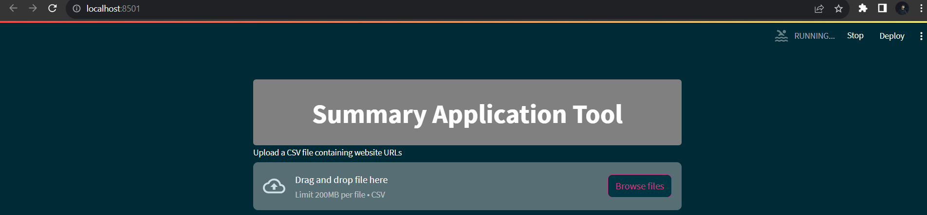

Slide 8
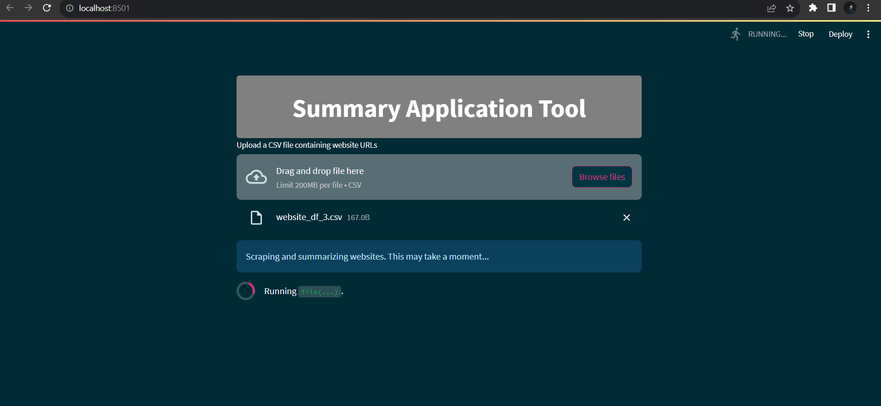

Slide 9
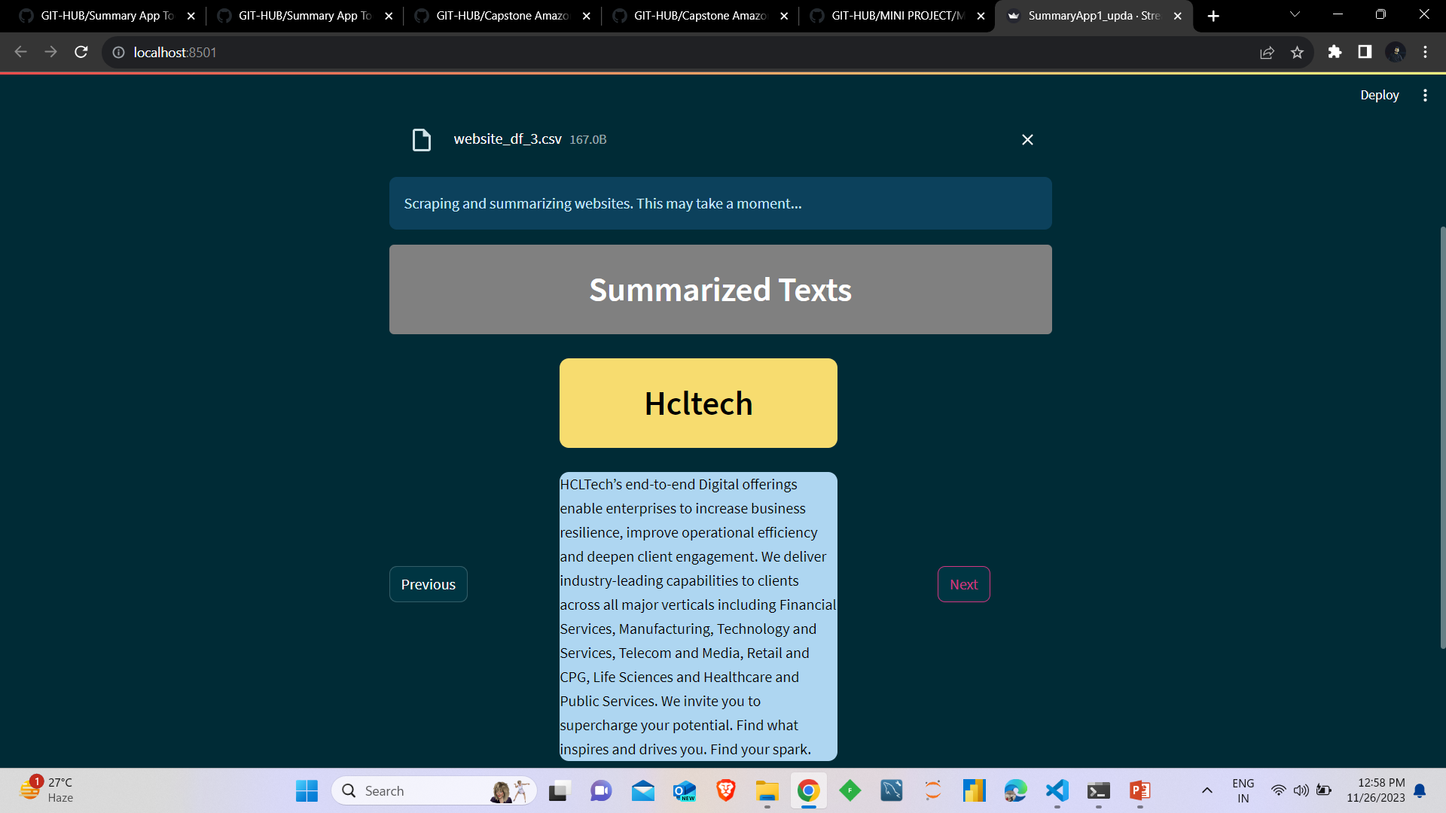

Slide 10
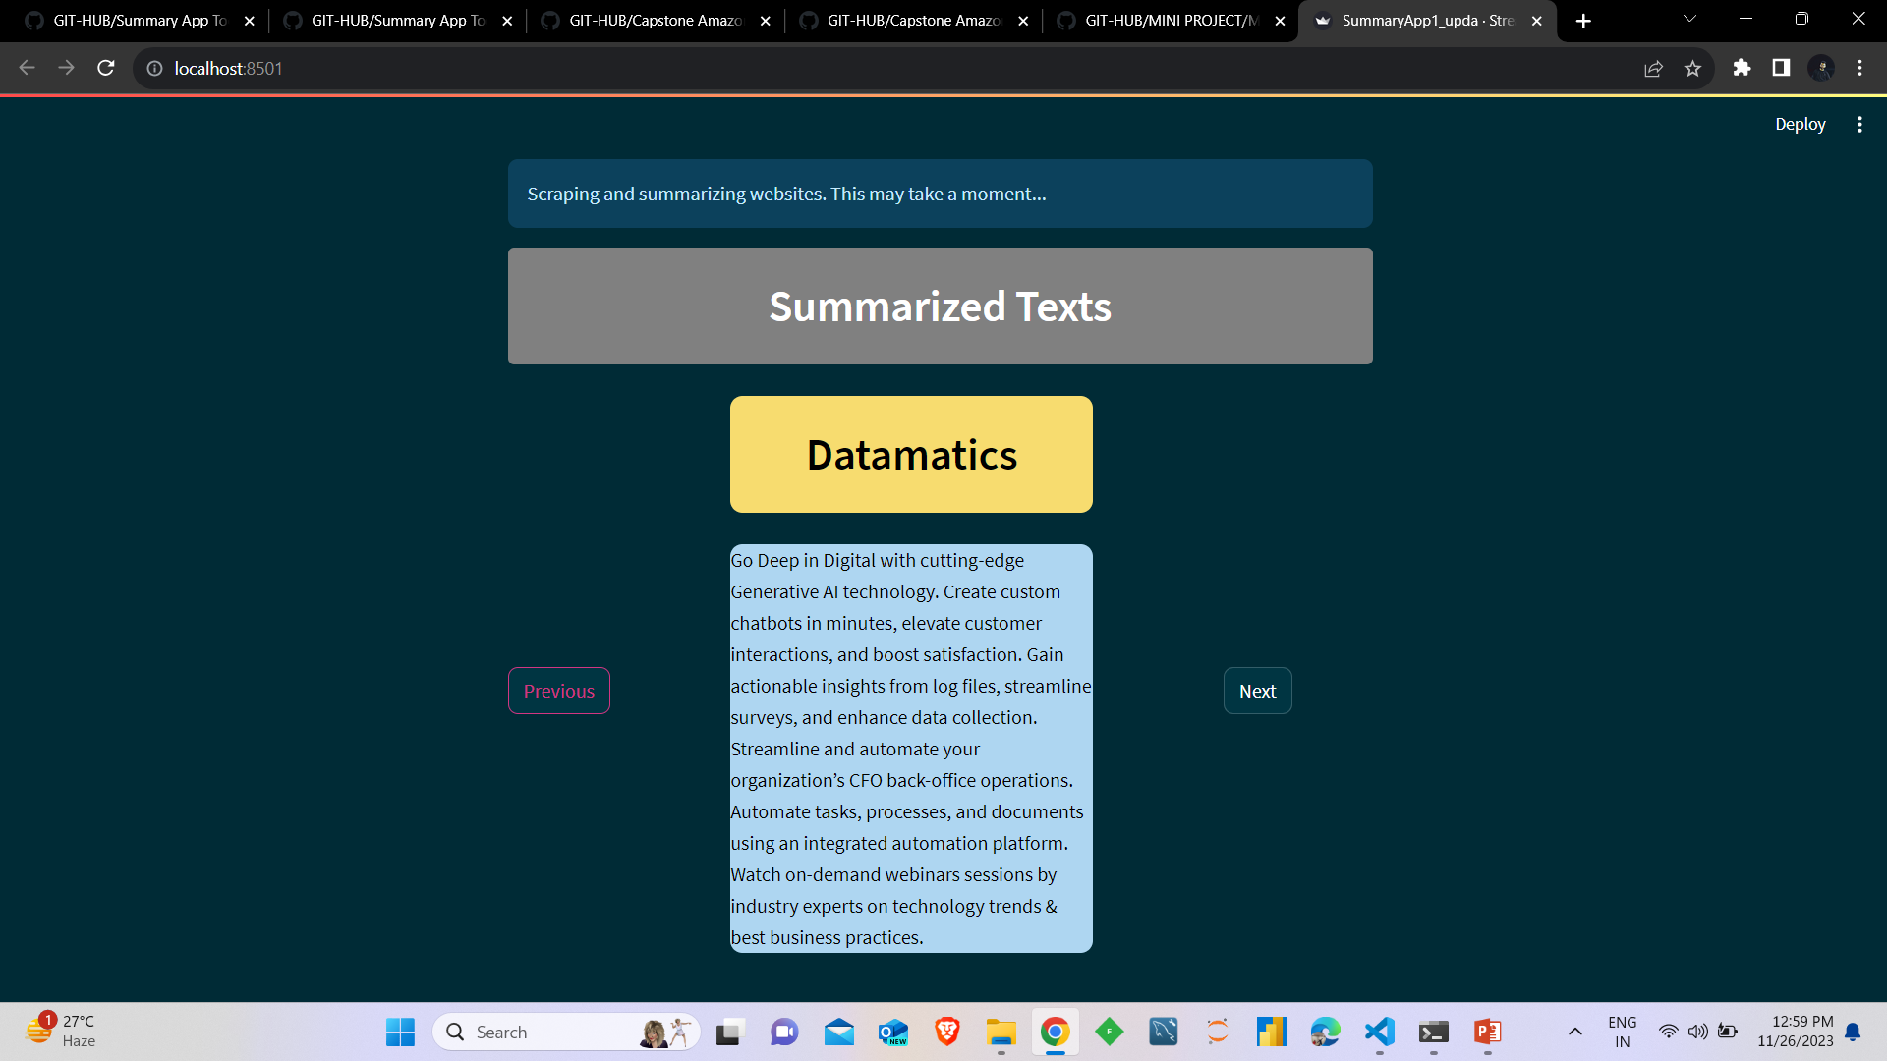

Slide 11
THANK YOU!!

